Slide 1
SANDBOX Training Tables
The Short name is the table alias name that will be used in naming other objects related to the table. Other objects include Constraints, Triggers and Indexes.
XX??_EMPLOYEES
XX??EMP
XX??_PAYROLL
XX??PAY
XX??_TIMECARDS
XX??TIM
XX??_PAYROLL_TAX_TYPES
XX?TAXTYP
XX??_PAYROLL_TAX_RATES
XX??RAT
XX??_COLORS
XX??COL
XX??_PAYROLL_LOG
XX??PAYLOG
XX??_DEBUG
??DEBUG
XX??_PAYROLL_YTD
XX??YTD
Joe Winnicki to use XXJW_ as prefix on all objects
Ryan Joaquim to use XXRJ_ as prefix on all objects
Jim Slanker to use XXJS_ as prefix on all objects

Slide 2
XX??_EMPLOYEES
CREATE TABLE XX??_EMPLOYEES
(
EMPLOYEE_ID NUMBER DEFAULT XX??_EMP_SEQ.nextval NOT NULL ,
NAME VARCHAR2(40) NOT NULL,
EMPLOYEE_TYPE VARCHAR2(10) NOT NULL, --SALARY,HOURLY,1099
DATE_CREATED TIMESTAMP(6) DEFAULT SYSDATE NOT NULL,
DATE_UPDATED TIMESTAMP(6),
FED_SSN NUMBER, --Length must be 9 digits, required for SALARY and HOURLY
FED_EIN NUMBER, --Length must be 9 digits 1099 Employees need this value or FED_SSN
HOURLY_RATE NUMBER, --Required when EMPLOYEE_TYPE = HOURLY or 1099
ANNUAL_SALARY NUMBER, --Required when EMPLOYEE_TYPE = SALARY
FAVORITE_COLOR_ID NUMBER, --Create Foreign Key constraint to COLOR_ID in XXHR_COLORS
PAYROLL_YTD NUMBER,
HIRE_DATE DATE NOT NULL,
TERMINATION_DATE DATE,
WORK_STATE VARCHAR2(40),
WORK_CITY VARCHAR2(40),
PRIMARY KEY (EMPLOYEE_ID));

Slide 3
XX??_TIMECARDS
FIELDS
TIMECARD_ID Primary Key
TIME_CARD_DATE Unique Index#1
EMPLOYEE_ID Unique Index#1 Foreign Key
HOURS
TYPE (WORK,VACATION,HOLIDAY,SICK)
PAYROLL_PROCESSED_YN (Default to N, Payroll will set to Y)

Slide 4
XX??_COLORS
FIELDS
COLOR_ID Primary Key
COLOR_CODE

Slide 5
XX??_PAYROLL
FIELDS
PAYROLL_ID Primary Key
PAYROLL_DATE Unique Index#1
EMPLOYEE_ID Unique Index#1 Foreign Key
GROSS_PAY
NET_PAY
FED_TAX
STATE_TAX
CITY_TAX
SSI_TAX
MEDICARE_TAX

Slide 6
XX??_PAYROLL_TAX_TYPES
FIELDS
TAX_TYPE_ID Primary Key
TAX_CODE (FED,STATE,CITY,SSI,MEDICARE)
DESCRIPTION

Slide 7
XX??_PAYROLL_TAX_RATES
FIELDS
TAX_TYPE_ID Primary Key Foreign Key
TAX_TYPE_QUALIFIER Primary Key (OHIO,BEDFORD HEIGHTS)
TAX_RATE

Slide 8
XX??_PAYROLL_LOG
FIELDS
LOG_ID Primary Key
PAYROLL_ID Foreign Key
PROCESSING_DATE
PROCESSING_MESSAGE
PROCESSING_STATUS (OK,ERROR,WARNING)

Slide 9
XX??_PAYROLL_YTD
FIELDS
PAYROLL_YEAR Primary Key
EMPLOYEE_ID Primary Key Foreign Key
GROSS_PAY
NET_PAY
FED_TAX
STATE_TAX
CITY_TAX
SSI_TAX
MEDICARE_TAX

Slide 10
XX??_DEBUG
FIELDS
SEQ_NO
TEXT
PROCEDURE_NAME
CREATED_BY
DATE_CREATED
CLIENT_PROGRAM_NAME

Slide 11
Query used to Generate test data for XX??_EMPLOYEES table 1 of 3
-------------------------------------------------------------------------------
-- Query to create test insert data for SANDBOX XX??_EMPLOYEES Tables --
-------------------------------------------------------------------------------
SELECT UPPER(user_first_name) || ' ' || UPPER(user_surname) name,
TRUNC(date_created) DATE_CREATED,
------------------------------------------------------------------------
-- Use DECODE function to assign Employee Type based on 1st character --
-- of Employee Last Name --
------------------------------------------------------------------------
DECODE(substr(user_surname,1,1),'A','1099',
'B','1099',
'C','1099',
'D','HOURLY',
'E','HOURLY',
'F','HOURLY',
'G','HOURLY',
'H','HOURLY',
'I','HOURLY',
'SALARY') employee_type, --Default
------------------------------------------------------------------------
-- Use DECODE function + DBMS_RANDOM.VALUE to assign FED_SSN based on --
-- 1st character of Employee Last Name --
------------------------------------------------------------------------
DECODE(substr(user_surname,1,1),'A',NULL,
'B',NULL,
'C',NULL,
trunc(DBMS_RANDOM.VALUE(230000001,289999999)) ) FED_SSN, --Default
------------------------------------------------------------------------
-- Use DECODE function + DBMS_RANDOM.VALUE to assign FED_EIN based on --
-- 1st character of Employee Last Name --
------------------------------------------------------------------------
DECODE(substr(user_surname,1,1),'A',trunc(DBMS_RANDOM.VALUE(890000001,919999999)),
'B',trunc(DBMS_RANDOM.VALUE(920000001,959999999)),
'C',trunc(DBMS_RANDOM.VALUE(960000001,989999999))
,NULL) FED_EIN, --Default
------------------------------------------------------------------------
-- Use CASE Statement + DBMS_RANDOM.VALUE to assign HOURLY_RATE based on
-- 1st character of Employee Last Name --
------------------------------------------------------------------------
CASE
WHEN substr(user_surname,1,1) in ('A','B','C','D','E','F','G','H','I') THEN ROUND(DBMS_RANDOM.VALUE(15,35),2)
ELSE NULL
END HOURLY_RATE,

Slide 12
Query used to Generate test data for XX??_EMPLOYEES table 2 of 3
------------------------------------------------------------------------
-- Use CASE Statement + DBMS_RANDOM.VALUE to assign ANNUAL_SALARY --
-- based on 1st character of Employee Last Name --
------------------------------------------------------------------------
CASE
WHEN substr(user_surname,1,1) in ('A','B','C','D','E','F','G','H','I') THEN NULL
ELSE ROUND(DBMS_RANDOM.VALUE(34000,150000),2)
END ANNUAL_SALARY,
------------------------------------------------------------------------
-- Pick Random number 1 thru 7 to assign FAVORITE_COLOR_ID --
------------------------------------------------------------------------
TRUNC(DBMS_RANDOM.VALUE(1,7)) FAVORITE_COLOR_ID,
------------------------------------------------------------------------
-- Add 3 days to created date to assign HIRE_DATE --
------------------------------------------------------------------------
TRUNC((date_created + 3)) hire_date,
------------------------------------------------------------------------
-- Set TERMINATION_DATE based on DATE_ACCESS_EXPIRED and DATE_REACTIVATED
------------------------------------------------------------------------
CASE
WHEN DATE_ACCESS_EXPIRED is NOT NULL
AND DATE_REACTIVATED is NULL THEN TRUNC(DATE_ACCESS_EXPIRED)
WHEN DATE_ACCESS_EXPIRED is NOT NULL
AND DATE_REACTIVATED is NOT NULL
AND DATE_ACCESS_EXPIRED > DATE_REACTIVATED THEN TRUNC(DATE_ACCESS_EXPIRED)
ELSE
NULL
END TERMINATION_DATE,
-- Default WORK_STATE to OHIO
'OHIO' WORK_STATE, -- Default all WORK_STATE to OHIO
------------------------------------------------------------------------
-- Use DECODE function to assign WORK_CITY based on 1st character of --
-- Employee Last Name M = CLEVELAND B = NORTH RIDGEVILLE the rest--
-- will be assigned to BEDFORD HEIGHTS --
------------------------------------------------------------------------
DECODE(substr(user_surname,1,1),'M','CLEVELAND',
'B','NORTH RIDGEVILLE',
'BEDFORD HEIGHTS') WORK_CITY --Default
from st_users st --STAR User Table in STAR Schema
where length(user_first_name) > 4 --Only select first names greater than 4 characters
AND (SELECT COUNT(*) from st_users st2 --Bypass entries where duplicate names exist in ST_USERS
WHERE UPPER(st2.user_first_name) = UPPER(st.user_first_name) --to avoid INSERT error in Sandbox XX??_EMPLOYEES table
AND UPPER(st2.user_surname) = UPPER(st.user_surname)) < 2;

Slide 13
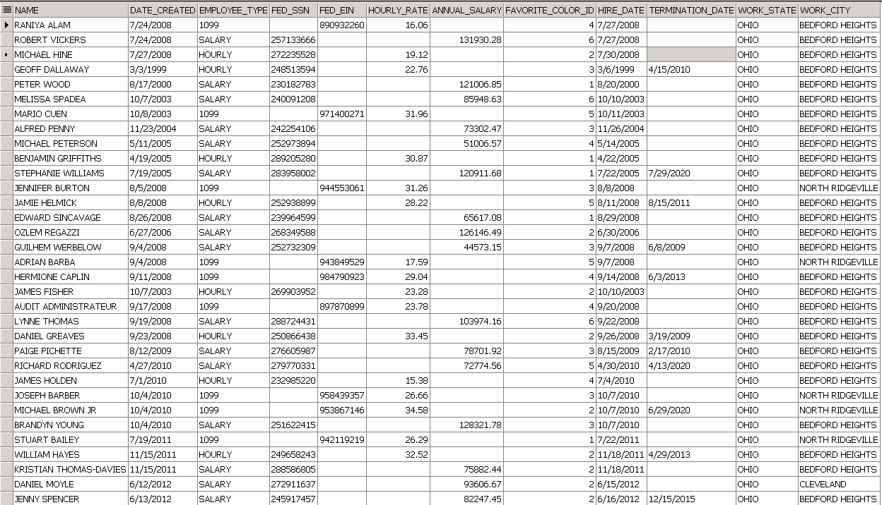
Query used to Generate test data for XX??_EMPLOYEES table 3 of 3

Slide 14
New Slide

